Slide 1
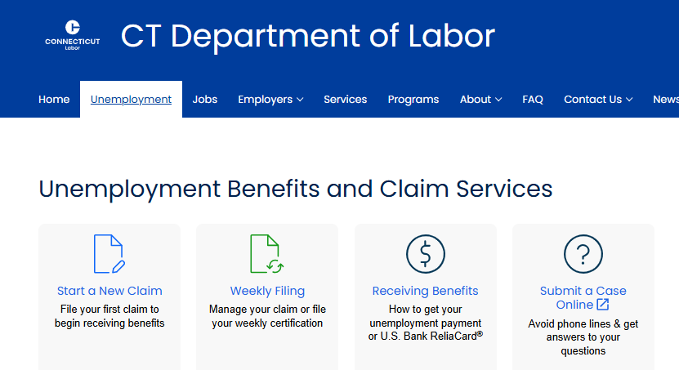
Unemployment Insurance and ReEmployCT Basics

Slide 2
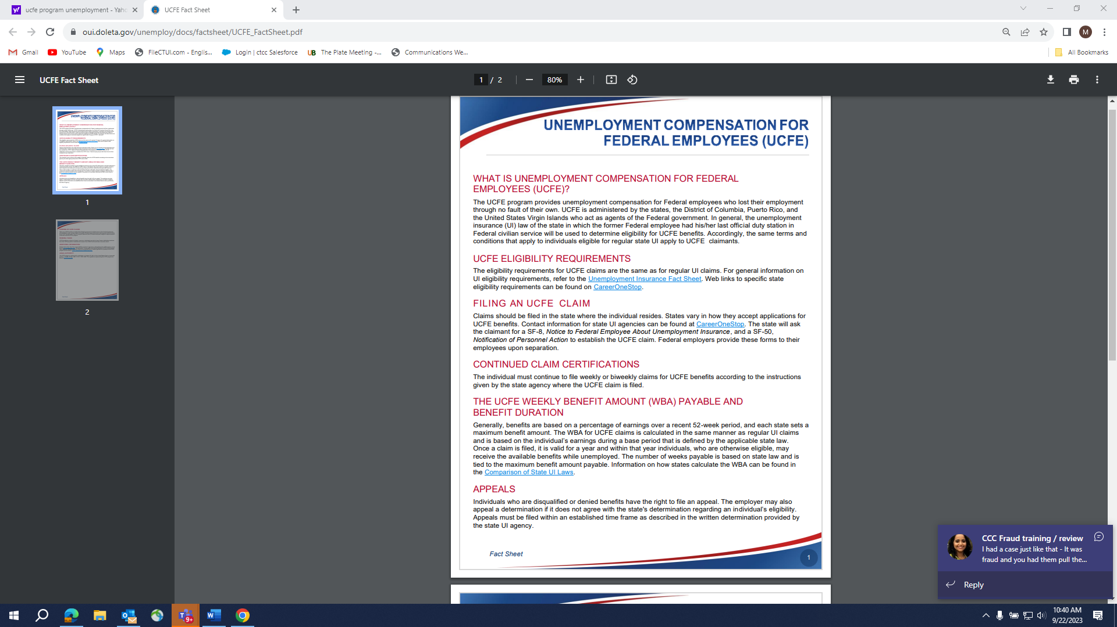
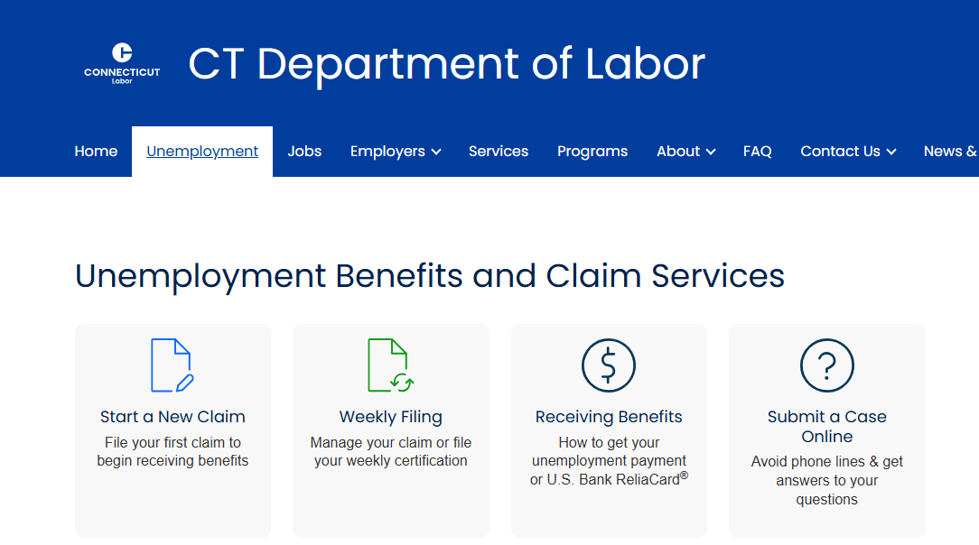
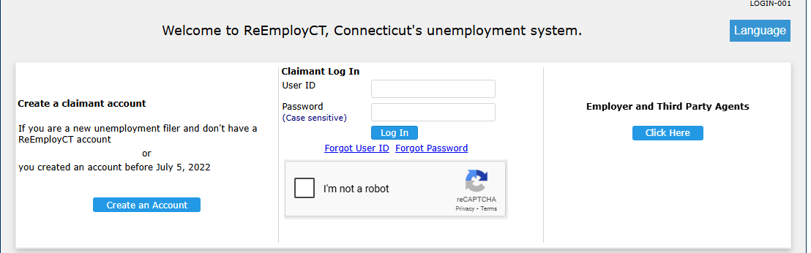
CONNECTICUT DEPARTMENT OF LABOR
CONSUMER CONTACT CENTER (CCC)
Filing a New or Weekly Unemployment Claim
www.filectui.com
Individuals can:
file a New Claim
file a Weekly Certification (Weekly Claim)
Weekly Filer
1st Time Filer
1st Time Filer
Weekly Filer

Slide 3
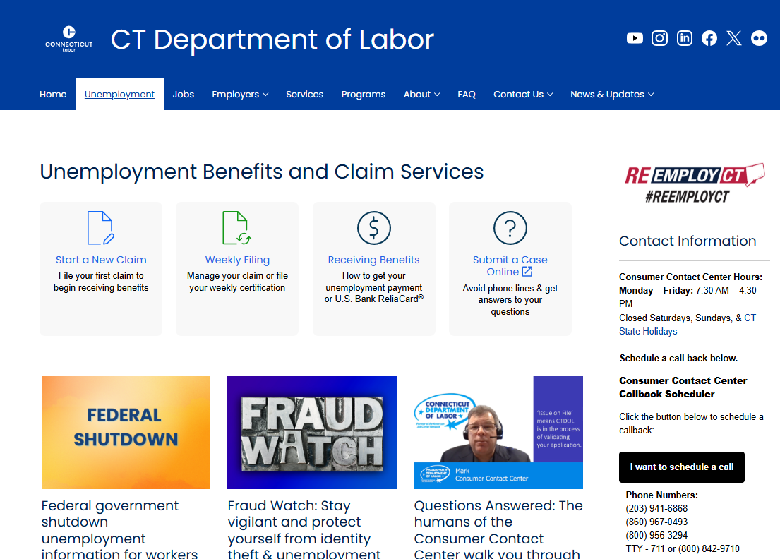
CONNECTICUT DEPARTMENT OF LABOR
CONSUMER CONTACT CENTER (CCC)
www.filectui.com
Consumer Contact Center is a direct link for Connecticut Department of Labor customers needing to file for Unemployment Insurance (UI), or for any question related to Unemployment or a customer’s benefits.

Slide 4
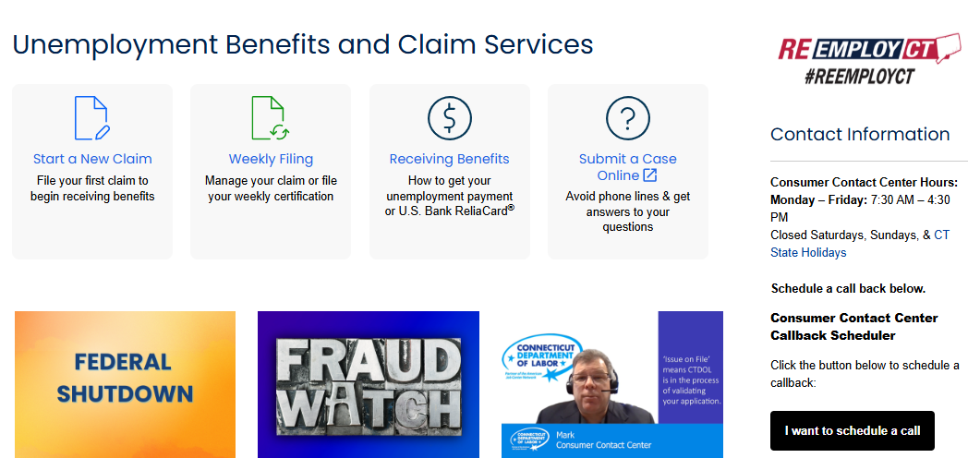
CONNECTICUT DEPARTMENT OF LABOR
CONSUMER CONTACT CENTER (CCC)
www.filectui.com
Response from Consumer Contact Center Agent within 48 hours
Next scheduled call response – February 2
Encourage Members to Use the Submit a Case Online Feature!

Slide 5
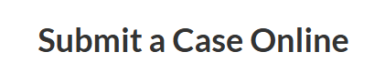
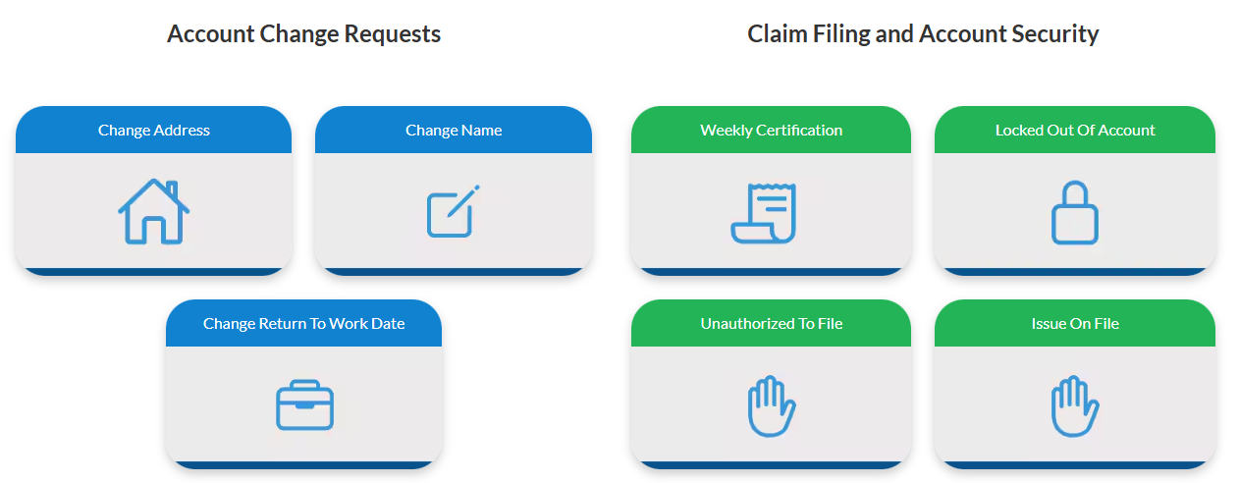
CONNECTICUT DEPARTMENT OF LABOR
CONSUMER CONTACT CENTER (CCC)
Submit a Case Online
www.filectui.com
Submit a Case Online Feature - Contact Center Agent will respond within 48 hours!

Slide 6
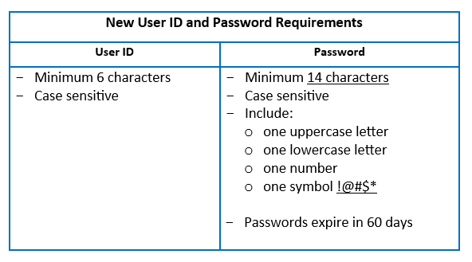
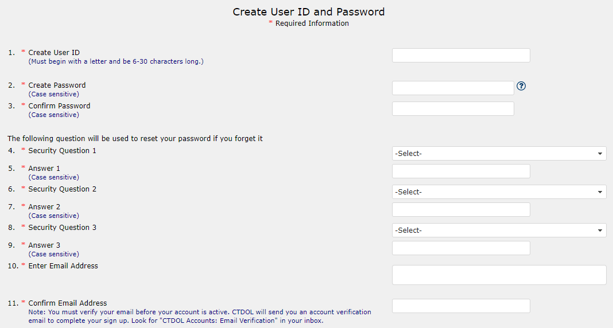
CONNECTICUT DEPARTMENT OF LABOR
CONSUMER CONTACT CENTER (CCC)
Create User ID and Password
www.filectui.com
Create User ID and Password screen
Complete all Required information
Select three (3) security questions, establish responses
Select Submit

Slide 7
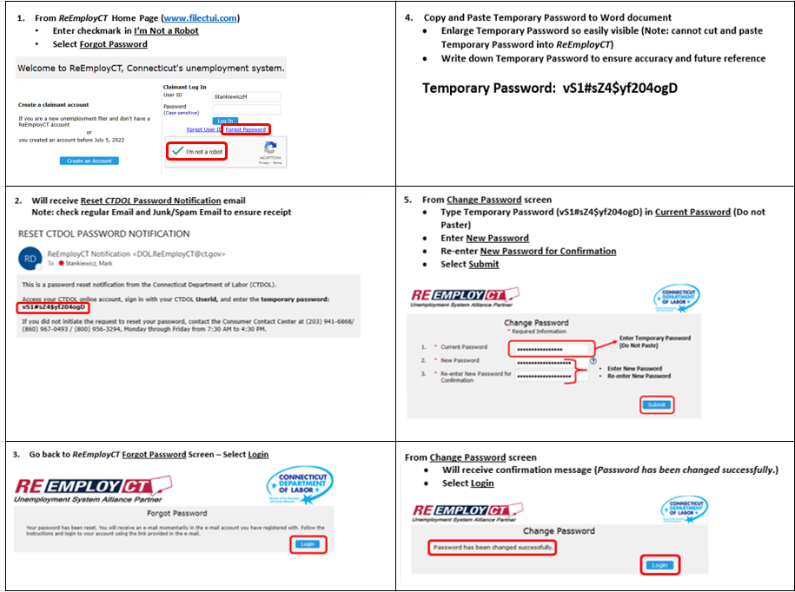
CONNECTICUT DEPARTMENT OF LABOR
CONSUMER CONTACT CENTER (CCC)
Locked Out of ReEmployCT Account – “Self Heal” Process

Slide 8
CONNECTICUT DEPARTMENT OF LABOR
CONSUMER CONTACT CENTER (CCC)
Locked Out of ReEmployCT Account – “Self Heal” Process (cont.)

Slide 9
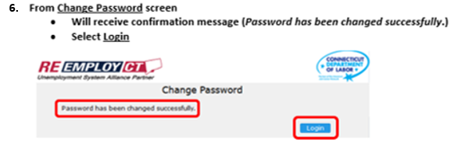
CONNECTICUT DEPARTMENT OF LABOR
CONSUMER CONTACT CENTER (CCC)
Locked Out of ReEmployCT Account – “Self Heal” Process (cont.)

Slide 10
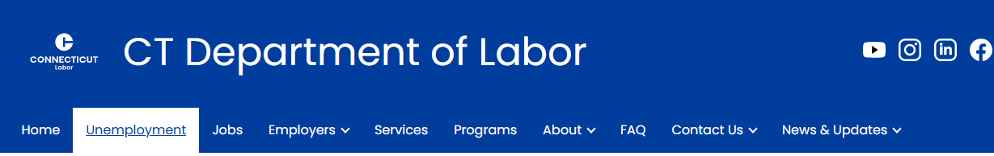
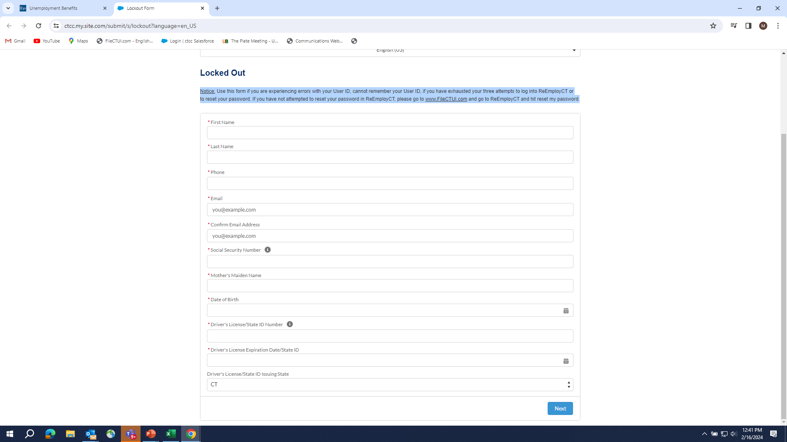
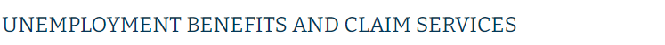
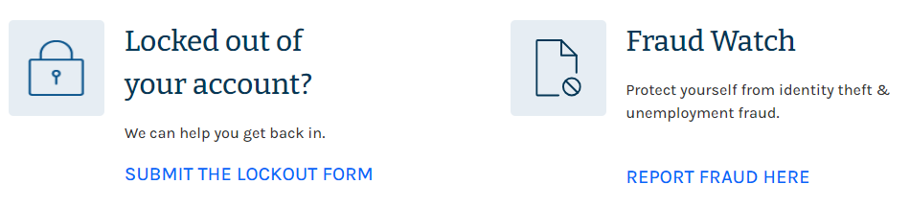
CONNECTICUT DEPARTMENT OF LABOR
CONSUMER CONTACT CENTER (CCC)
Locked Out of Your Account – Ask for Help
1
2
Use Form If:
experiencing errors with/cannot remember User ID
cannot remember Password
exhausted three (3) attempts to log into ReEmployCT
exhausted three (3) attempts to reset Password in ReEmployCT
Note: If not attempted to reset Password in ReEmployCT, go to www.filectui.com, select Reset My Password

Slide 11
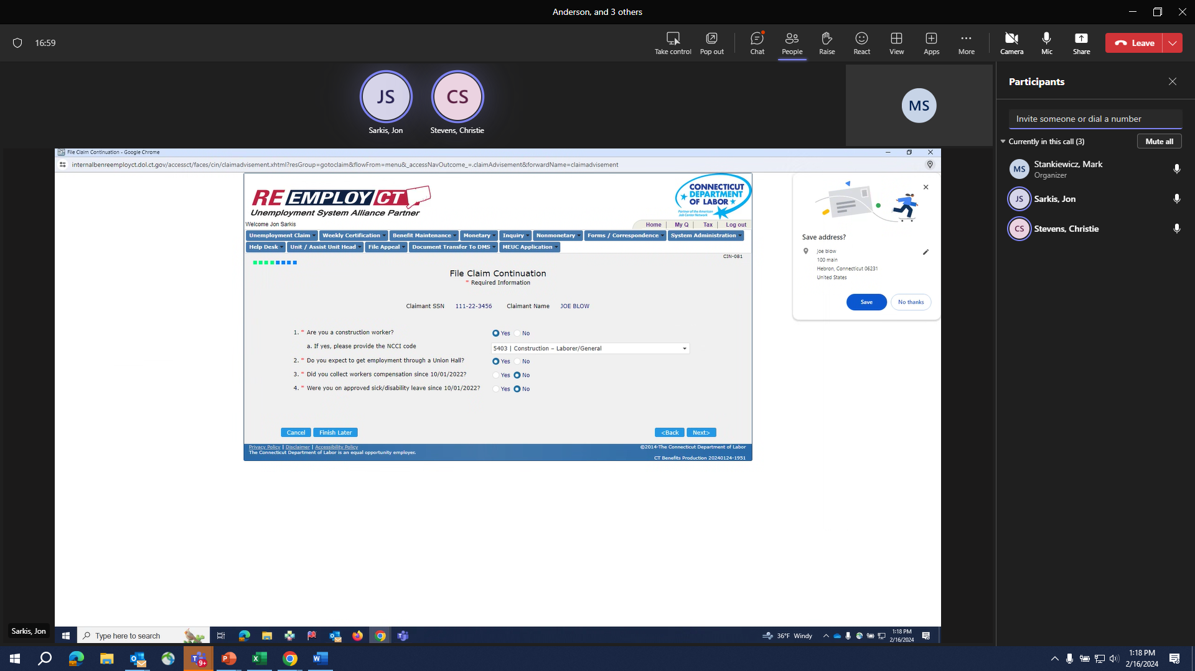
CONNECTICUT DEPARTMENT OF LABOR
CONSUMER CONTACT CENTER (CCC)
Work Search Waivers
Exemptions from Work Search Requirements
member of Trade Union and connected to Union Hiring Hall
Return to Work date within 13 weeks of filing initial Unemployment claim
obtained new job that starts within 13 weeks of Claim Start Date
File Claim Continuation screen:
Answer YES to Are you a construction worker?
Provide NCCI code for associated trade (Drop down list)
Answer YES to Are you a member of a trade union?
**If Claimant answers questions correctly, omitted from Work Search Requirement
National Council on Compensation Insurance (NCCI): Class codes are four digits that help identify the type of work. Insurance companies use Class codes to estimate exposure to risk while determining workers’ compensation insurance.

Slide 12
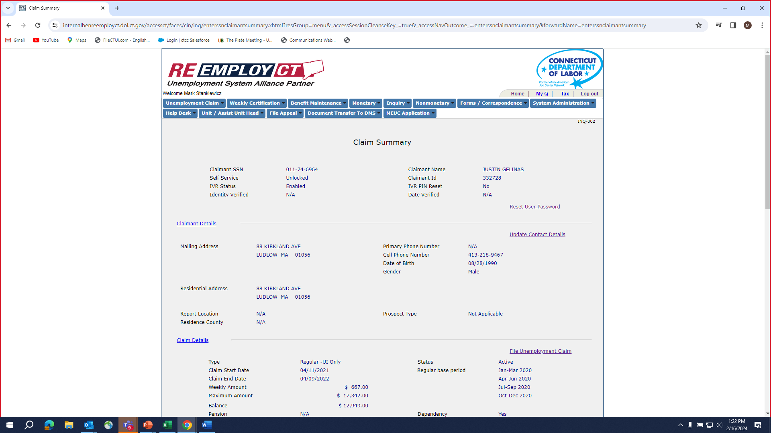
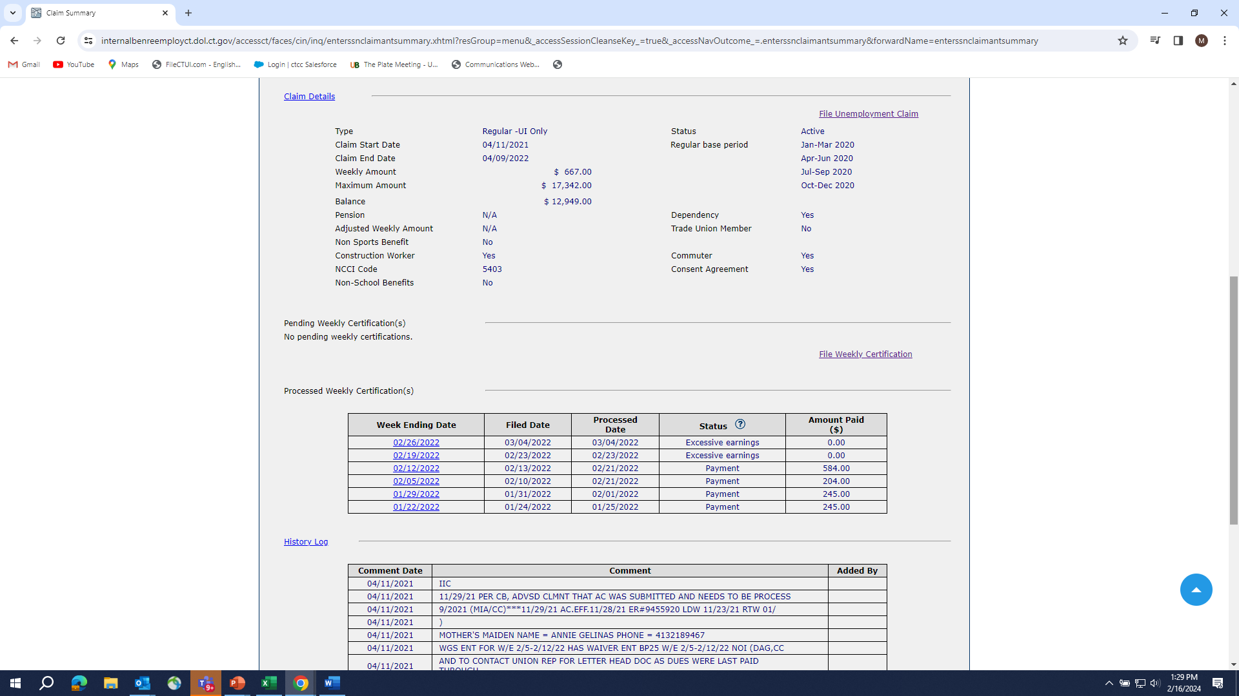
CONNECTICUT DEPARTMENT OF LABOR
CONSUMER CONTACT CENTER (CCC)
Work Search Waivers (Verification of Correct Entries)
From Claim Summary screen
Claim Details section:
Construction Worker - Yes
NCCI Code - Completed
Trade Union Member - Yes
Consumer Contact Center Agent reviews Claimant’s (Union Member) Summary to ensure Work Search Waiver requirements/entries are completed accurately: Trade Union Member, Construction Worker, NCCI Code.

